Slide 1

Model Deployment on Cloud
Machine Learning Model Deployment on Cloud

Slide 2
Overview of Model Deployment
Understand the benefits of deploying models on the cloud.
1
Learn to load a machine learning model from Hugging Face.
2
Build a FastAPI application to serve the model.
3
Deploy the model on GKE using a YAML configuration file.
4

Slide 3
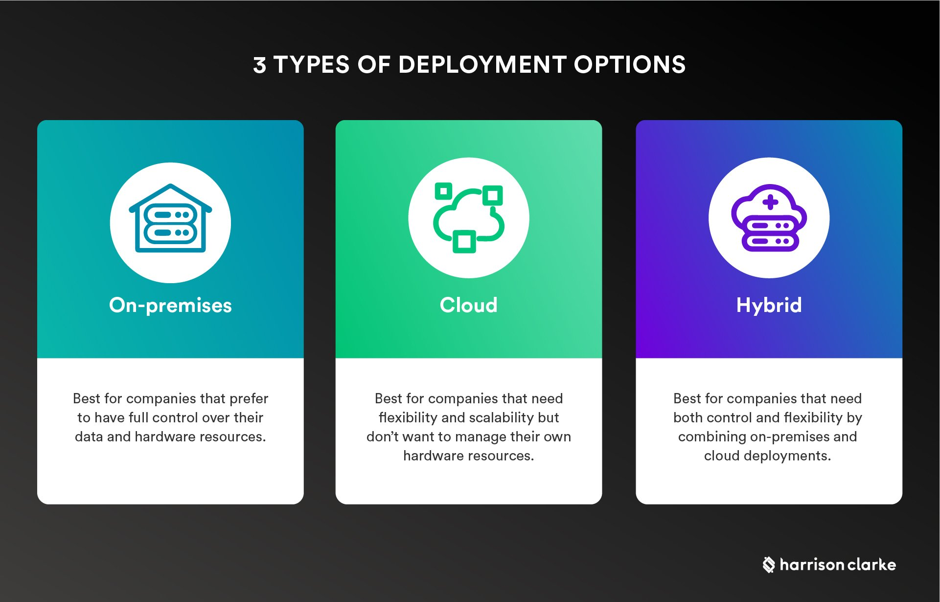
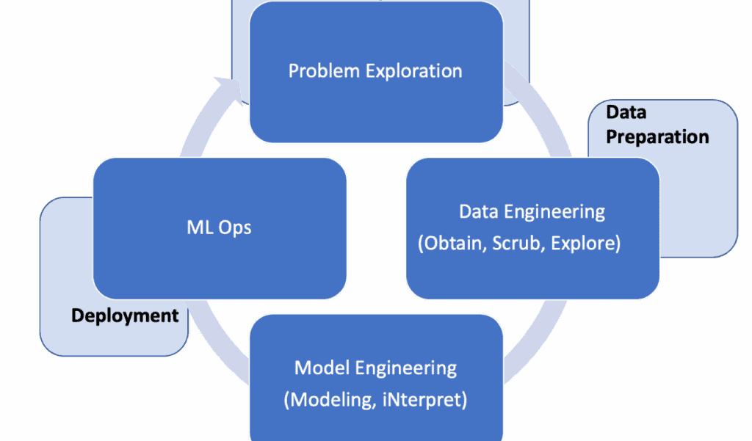
Introduction
What is model deployment?
Why is the cloud ideal for model deployment?

Slide 4


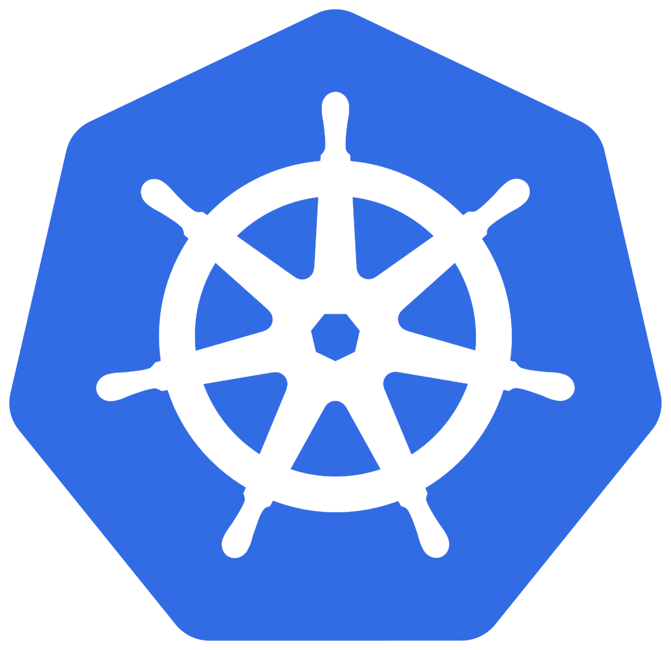
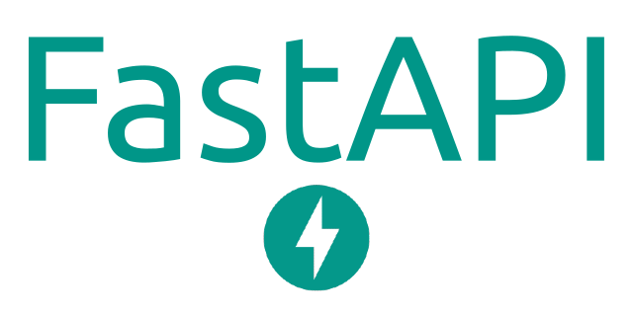
Fundamental Concepts
Hugging Face - An open-source machine learning models and pipelines platform.
01
FastAPI - A modern Python framework for building RESTful APIs.
02
Docker - A tool for containerizing applications, making them portable and scalable.
03
Kubernetes - A container orchestration system for managing the deployment and lifecycle of applications.
04

Slide 5
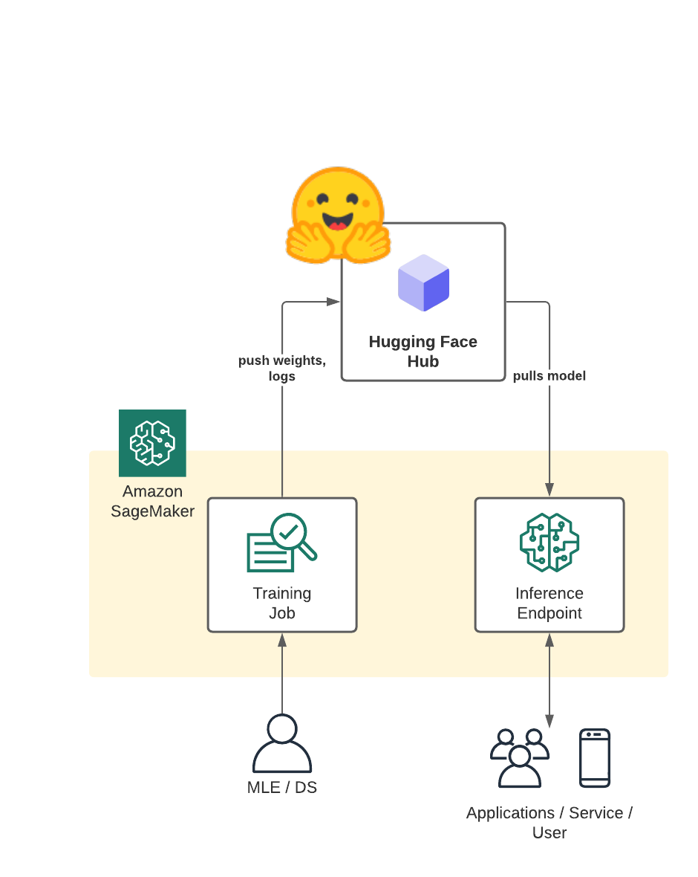
Loading a Model from Registry

Slide 6
Building the FastAPI Application
Creating
Creating API routes to receive input data and return the model's predictions.
Implementing
Implementing the model's inference logic within the API.

Slide 7
Dockerizing the Application
Building a Dockerfile to containerize the FastAPI application.
Specifying dependencies and command-line arguments within the Dockerfile.

Slide 8
Deployment on Google Kubernetes Engine
Creating
Creating a GKE cluster and configuring access.
Defining
Defining a YAML configuration file to deploy the Dockerized application on GKE.

Slide 9
Visualizing logs and metrics from the deployed application on GKE.
Lens Metrics (infra)
Prometheus / Grafana (infra)
Weighs and Biases (model)

Slide 10
Thanks !
https://www.linkedin.com/in/douglas-diniz-landim/
https://github.com/ddlandim/ml-deploy

